Slide 1
Primitive Types and Operators

Slide 2
Today’s agenda
Practice the declaration and initialisation of variables.
Describe the primitive types supported in Java 11.
List the common Java operators you will need as beginners.
Identify operator precedence (and the common problems faced by new programmers).

Slide 3
A Java program (class) definition
/*
* First Java Program
*/
package welcome;
/**
* @author School of Computing, Engineering & Digital Technologies
*/
public class Welcome {
/**
* @param args the command line arguments
*/
public static void main(String[] args) {
System.out.println("Welcome to Java Programming");
}
}
package (group name) generated by NetBeans
class: a Java keyword
filename matches class name
main() method: program entry point
each method contains processing statement(s)
closing } aligned to left

Slide 4
Variables in Java
There are two broad types of variables:
Primitive variables (provided by the language).
Reference variables (a.k.a. as objects that are created at will by the programmer). We will cover these in a later lecture.
Let’s take a deeper dive into variables covering:
Types.
Declaring and initialising.
Ranges.
Loss of precision through casting.
Binary and unary arithmetic operators.
Operator precedence.

Slide 5
Data types
To help process and store data efficiently, programs need to know the type of data being used. Most programming languages support the following data types:
Name | Example | Example Values
Text (string) | Customer Name Staff Name Product Description | “John Smith” “Sally Jones” “Laptop”

Slide 6
Data types
To help process and store data efficiently, programs need to know the type of data being used. Most programming languages support the following data types:
Name | Example | Example Values
Text (string) | Customer Name Staff Name Product Description | “John Smith” “Sally Jones” “Laptop”
Numeric (whole numbers integers) | Quantity Mark | 55 67

Slide 7
Data types
To help process and store data efficiently, programs need to know the type of data being used. Most programming languages support the following data types:
Name | Example | Example Values
Text (string) | Customer Name Staff Name Product Description | “John Smith” “Sally Jones” “Laptop”
Numeric (whole numbers integers) | Quantity Mark | 55 67
Numeric (real numbers floating point) | Price Weight Discount Percentage | 34.95 25.2 10.00

Slide 8
Data types
To help process and store data efficiently, programs need to know the type of data being used. Most programming languages support the following data types:
Name | Example | Example Values
Text (string) | Customer Name Staff Name Product Description | “John Smith” “Sally Jones” “Laptop”
Numeric (whole numbers integers) | Quantity Mark | 55 67
Numeric (real numbers floating point) | Price Weight Discount Percentage | 34.95 25.2 10.00
Boolean (flag Yes/No or True/False) | Trade Account Manager Passed | True No Yes

Slide 9
Data types - over to you!
Select an appropriate data type (text, numeric integer/real, or Boolean) and give an example for each of the following:
Description | Type and Value
Student name
Mobile telephone number
Club member (is a?)
Email address
Age
Monthly pay
Post code

Slide 10
Java’s primitive data types
Java supports 8 primitive date types.

Slide 11

Primitive data types
Java is a statically-typed language. This means that the type of each variable must be declared before use.
A variable’s type determines the values it may contain, plus the operations that may be performed on it.
There are eight primitive data types supported by the Java programming language.
We will be concentrating on four of them in the early exercises:
int, double, char, and boolean.

Slide 12

Numerical types in Java
Numerical data can be;
an integer (whole number),
fractional (with decimal point).
An integer primitive type in Java is int.
A fractional primitive type in Java is double.
As mentioned, other primitive types include:
byte, short, long, float, char, and boolean.

Slide 13
Syntax of declaring a primitive variable
To declare a primitive variable that has no value assigned to it, use the following format:
<type> <identifier>;
Once you have declared a variable you can assign a value to it:
<identifier> = <value>;
To declare and initialise a variable with value in one line, use the following format:
<type> <identifier> = <initial value>;

Slide 14
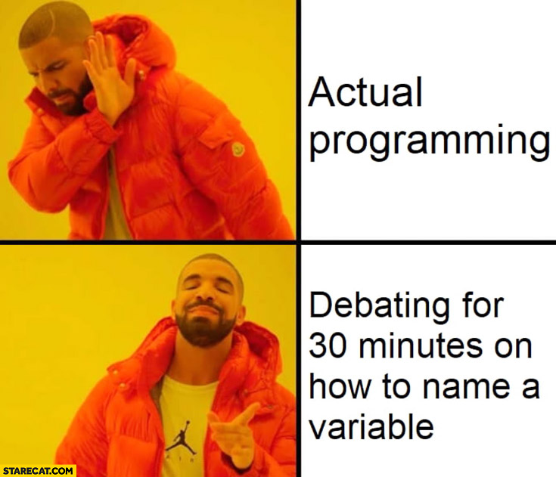
Naming “things”
Identifiers are names we give programs and variables.
Can contain alphabetic, numeric, underscore _ or $ symbols only.
Must not start with a number.
Java is CASE sensitive.
camelCase convention:
Capital letters for the start of each word in an identifier (no spaces allowed) except for the first one!
e.g. firstName, heightLimit, number1, interestRate.

Slide 15
Declaring a primitive variable
Syntax type identifier;
Examples int tvChannel;
double volume;
double temperature;
We can give initial values to the data members (aka. initialisation) :
int tvChannel = 5;
double volume = 11.0;
double temperature = 28.6;

Slide 16
Primitive variables (int)
The int data type is used to store whole numbers.
It has a minimum value of -2,147,483,648 and a maximum value of 2,147,483,647 (inclusive).
This data type will usually be large enough for the numbers your program will use.
To declare and initialise a variable of type int:
int bingo; //<type> <identifier>;
int gameNum = 48; //<type> <identifier> = <value>;

Slide 17
Primitive variables (double)
The double data type is used to store floating point numbers (number that can contain a fractional part).
It has a minimum value of -1.79 x 10308 and a maximum value of +1.79 x 10308 (inclusive) - 15 significant figures of accuracy.
This is the range for a 64-bit signed floating-point number.
This is the default choice for floating points.
To declare and initialise a variable of type double:
double markup; // <type> <identifier>;
double overtimeRate = 1.5; // <t> <id> = <val>;

Slide 18
Primitive variables (char)
Used for storing single alphanumerical characters.
International – All 65,000 Unicode characters are available.
Unicode provides a unique number for every character, no matter what the platform, no matter the language.
The Unicode standard allows the use of languages with alphabets that cannot be represented with only 256 characters i.e. extended ASCII.
To declare and create a variable of type char:
char grade; // <type> <identifier>;
char top = 'A'; // <type> <identifier> = <value>;
char vowel = '\u00F6'; // O with an umlaut(Ö)

Slide 19
Primitive variables (boolean)
The boolean data type has only two possible values:
true or false.
This data type is often used to provide simple flags that track true or false conditions.
For example, you might use a boolean variable to record whether some coursework has been submitted.
To declare and create a variable of type boolean:
boolean workSubmitted; // <type> <identifier>
boolean onTime = true; // <type> <identifier> = <value>;

Slide 20
Primitive default values
If you do not assign a variable an initial value, then the compiler will set a reasonable default for you:
Data Type | Default Value
int | 0
double | 0.0
char | '\u0000' (unicode for NULL)
boolean | false

Slide 21
Summary: Primitive variables
So far, we have created variables using:
<type> <identifier>; // or
<type> <identifier> = <initial value>;
You can also change the value stored in a variable after it has been assigned:
int bingoNumber = 42;
bingoNumber = 35;
In the code above bingoNumber, which is of type int, is assigned an initial value of 42.
The next line of code changes that value to 35.
Note that you only declare the type of a Java variable once, but you can change the value many times.

Slide 22
Printing the value of variables
We can now create variables of primitive data type, and we can change their values.
…how do we check the values?
One option is to print the value out to the console or output window.
Sometimes this is known as printing to console.
To do this we use the System class.
A java application can write to the console using:
System.out.println(output);

Slide 23
println()
System.out.println(output);
Semi-colon
The System class is part of the java.lang package. It provides access to the native operating system's environment, including the console
Dot separators
A method called println() which prints the arguments and adds a newline character
Arguments to the method.
Note to print without a newline character, use the print() method instead.

Slide 24
Operators
Building expressions.

Slide 25
Assignment operator
Now that we've learned how to declare and initialise variables, you probably want to know how to do something with them.
Operators are special symbols that perform specific operations on one or two operands, and then returns a result.
We have already seen the assignment operator =
It takes two operands.
It assigns the value of the operand on the right to the operand on the left:
Syntax: <operand1> = <operand2>;
Example: int bingoNumber = 42;

Slide 26
Arithmetic operators (part 1.)
The Java programming language provides operators that perform addition, subtraction, multiplication, and division.
There's a good chance you'll recognise them by their counterparts in basic mathematics.
The only symbol that might look new to you is "%", which divides one operand by another and returns the remainder as its result.
OPERATOR | EXPLANATION
+ | Addition operator
- | Subtraction operator
* | Multiplication operator
/ | Division operator
% | Remainder operator

Slide 27
Arithmetic operators (part 2.)
Like the assignment operator, the arithmetic operators are binary operators.
This means they have two operands, separated by the operator itself:
Syntax: <operand1> + <operand2>;
Example: result + 42;
The operands can be either numbers or variables.
For example,
int dozen = 12;
int anotherOne = 1;
int bakersDozen = dozen + anotherOne; // i.e. 13
System.out.print(dozen / 2); // prints 6

Slide 28
Casting (part 1.)
A variable of type int can only store whole numbers.
If you attempt to store a floating-point number in a variable of type int then the decimal places will be ‘chopped off’.
This is not anything as sophisticated as rounding – the floating points are just lost!
In Java parlance, this is known as a loss of precision.
i.e. No room for the decimal places in memory.
It can be very serious, depending on the application and the need for accuracy.

Slide 29
Casting (part 2.)
The following assignment will generate a compile time error:
int foo;
double bar = 3.2;
foo = bar; // error, no place for the decimal
You can force this assignment with something called an explicit cast:
foo = (int) bar;
This re-assures the compiler that you don’t mind the loss of precision.

Slide 30
Unary operators
In contrast, unary operators require only one operand.
They perform various operations such as incrementing or decrementing a value by one, negating expressions, and inverting Boolean values.
Note ++ and -- can pre-fix or post-fix.
OPERATOR | EXPLANATION
++ | Increments value by one
-- | Decrements value by one
- | Negates an expression
! | Inverts value of a boolean

Slide 31
Examples of unary operators
Operator | Example | Explanation
pre increment ++a | a = 5; x = ++a; | increment a then use this new value in the expression. x is 6, a is 6
post increment a++ | a = 5; x = a++; | use current value of a in expression, then increment a. x is 5, a is 6
pre decrement --a | a = 5; x = --a; | decrement a then use this new value in expression. x is 4, a is 4
post decrement a-- | a = 5; x = a--; | use current value of a in expression, then decrement a. x is 5, a is 4

Slide 32
Compound assignment operators
Java has several compound assignment operators.
These allow you to apply an arithmetic operator and an assignment operator simultaneously.
Example:
num += 6;
This is the same as writing:
num = num + 6;
This is more efficient than the full expression but may be hard to understand at first.

Slide 33
Compound assignment examples
Operator | Example | Explanation
+= | a += 3 | a = a + 3
-= | b -= 9 | b = b - 9
*= | c *= 12 | c = c * 12
/= | d /= 3 | d = d / 3
%= | f %= 12 | f = f % 12

Slide 34
Operator precedence (part 1.)
There is a mathematical tradition that some arithmetic operations are done before others.
This is important because operator precedence in a complicated calculation can drastically change the result:
Example: If A = 5, B = 5 and C = 50.
Calculate: A + B * C
Did you answer 500 or 255?

Slide 35
Operator precedence (part 2.)
Java has the following rules for operator precedence (simplified table):
Higher precedence operators are done before lower precedence. When deciding precedence between two operators from the same category, use left to right evaluation.
Category | Symbol
Unary operators Postfix first | expr++ expr-- ++expr --expr - !
Multiplicative | * / %
Additive | + -
Assignments Including compound | = += -= *= /= %=
Higher Priority

Slide 36
Operator precedence (part 3.)
Back to the example:
Example: If A = 5, B = 5 and C = 50.
Calculate: A + B * C
Category | Symbol
Unary operators | ++ -- - !
Multiplicative | * / %
Additive | + -
Assignments | =

Slide 37
Operator precedence (part 4.)
The full table of operator precedence is hideously complicated.
It has 14 separate categories.
Many Java courses spend a long time deciphering it.
We are not going to because it is easy to work around the problem with less ambiguous code or parenthesis
Parenthesis () can be used to force a particular order.
(a+b)*c forces the a+b to be calculated first.
If in doubt, break the code into separate lines (instructions).

Slide 38

Requirement analysis - Sales Exercise
Sales staff are paid a percentage of the sale amount as a commission on each order they process.
To calculate an amount paid to staff what are the:
Values?
Processes?
Outputs?
List the Java variables and data types.
List two example values for each variable.

